Slide 1

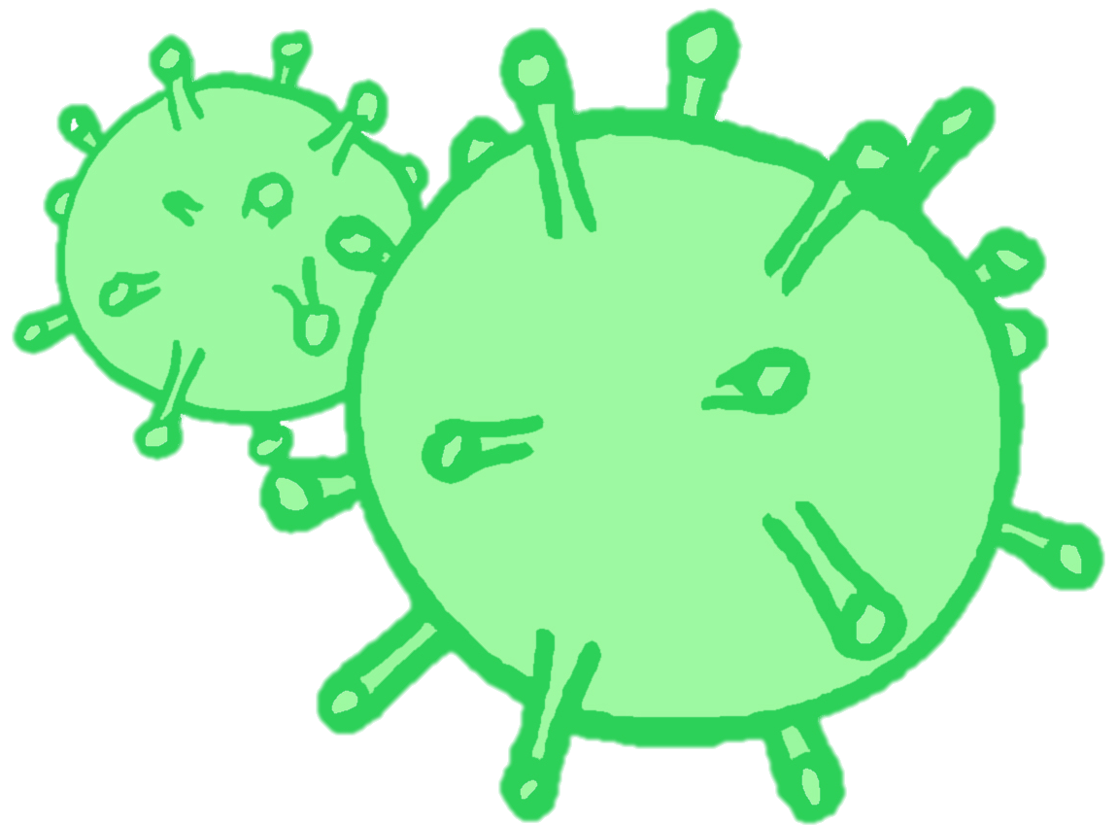
CONTRACEPTION & STI’s
Year 10 Health Lesson 4 Term 2, 2024

Slide 2

Today’s Focus
Topic Test.

Slide 3
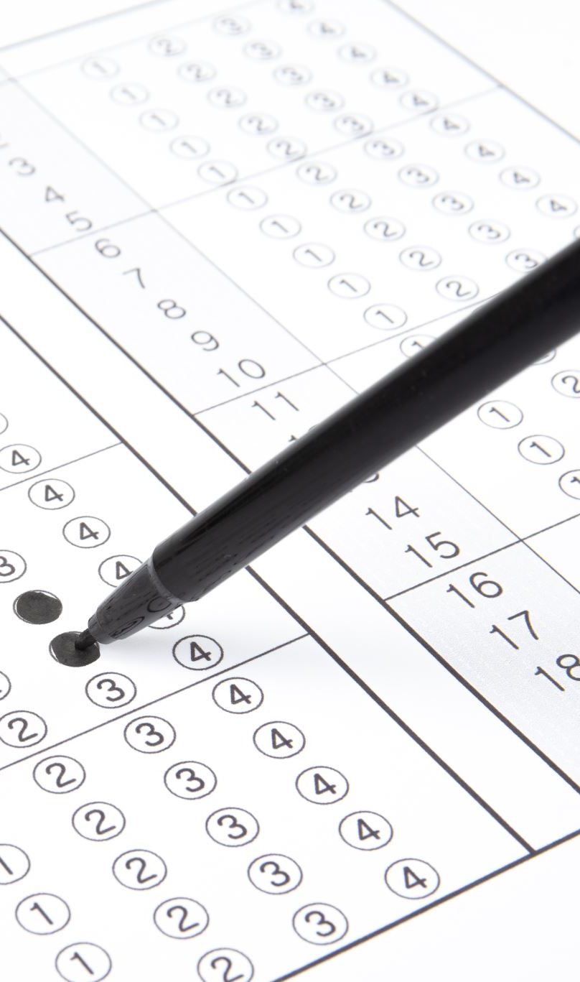
Test CONDITIONS:
You have ONE period to complete the test
Separate all desks.
You need a pen.
No talking or cheating.
May result in a loss of marks/score of 0.
Raise your hand if you finish early or have a question.

